Slide 1
Person-Centered Healthcare Delivery: Centering Patient Experience in Accessing Care from Home
April 27, 2022
Notes:
Notes Page Title Here
(edit this in notes view)

Slide 2
Welcome to Today’s Webinar
Thank you for joining us to learn about how telehealth and house call visits are two approaches that have helped people with disabilities access health care while avoiding the challenges of leaving their home for healthcare.
This webinar series is sponsored by the National Center on Advancing Person-Centered Practices and Systems. NCAPPS is funded by the Administration for Community Living (ACL) and Centers for Medicare & Medicaid Services (CMS).
NCAPPS webinars are free and open to the public.
Alixe Bonardi
Bevin Croft
abonardi@hsri.org
bcroft@hsri.org
NCAPPS Co-Director at HSRI
NCAPPS Co-Director at HSRI
Notes:
Notes Page Title Here
(edit this in notes view)

Slide 3
The goal of NCAPPS is to promote systems change that makes person-centered principles not just an aspiration but a reality in the lives of people across the lifespan.

Slide 4
Webinar Logistics
Participants will be muted during this webinar. You can use the chat feature in Zoom to post questions and communicate with the hosts.
Toward the end of the webinar, our speakers will have an opportunity to respond to questions that have been entered into chat.
The webinar will be captioned in English and Spanish. To access the Spanish captions, please use this link: https://www.streamtext.net/player?event=HSRI
El seminario de web estará subtitulado en vivo en Inglés y Español. Para tener acceso a los subtítulos en Español, utilice este enlace: https://www.streamtext.net/player?event=HSRI
This live webinar includes polls and evaluation questions. Please be prepared to interact during polling times.

Slide 5
Feedback and Follow-Up
After the webinar, you can send follow-up questions and feedback about the webinar to NCAPPS@hsri.org.
(Please note that this email address is not monitored during the webinar.)
The recorded webinar, along with a pdf version of the slides and a Plain Language summary, will be available within two weeks at NCAPPS.acl.gov. We will also include questions and responses in the materials that are posted following the webinar.

Slide 6
Who’s Here?
“In what role(s) do you self-identify? Select all that apply.”
Person with a disability/person who uses long-term services and supports
Family member/loved one of a person who uses long-term services and supports
Self-advocate/advocate
Peer specialist/peer mentor
Social worker, counselor, or care manager
Researcher/analyst
Community or faith-based service provider organization employee
Government employee (federal, state, tribal, or municipal)
Hospital/hospital-affiliated clinic employee
HMO/managed care organization employee

Slide 7
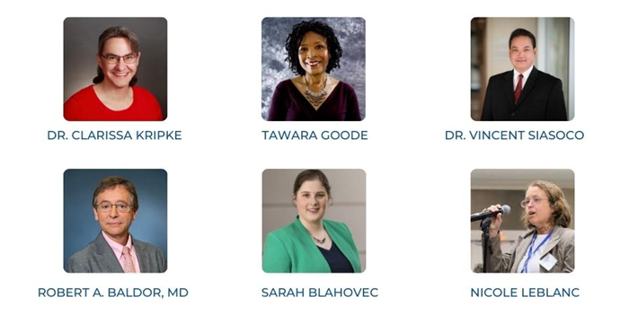
Meet Our Speakers

Slide 8
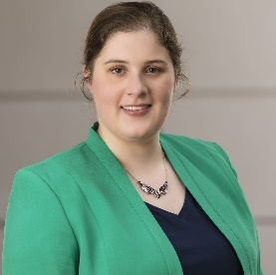
Impacts of the Pandemic on Healthcare
Telehealth is becoming more accepted. Prior to COVID there was resistance on telehealth and if quality of care could be upheld in a virtual way.
Independent doctors are going bankrupt and moving to large scale medical practices. The era of the sole practitioner is over!
Major decline in preventive healthcare and visits for chronic health issues due to fear of COVID.
LeBlanc, N. (2021, November). Removing Barriers to Healthcare: A New Era for House Calls? National Center on Advancing Person-Centered Practices and Systems. Retrieved from https://ncapps.acl.gov/docs/Resources/Removing%20Barriers%20to%20Healthcare%20A%20New%20Era%20for%20House%20Calls%20Accessible%20Edited.pdf

Slide 9
Pandemic Lessons Learned
The healthcare challenges people with developmental disabilities and their families face on a regular basis are enormous and need to be highlighted.
The time is now for us to build a society and healthcare system that plans for disability and is accommodating to our unique needs. If we all live long enough, we will all join the disability club.
So, the time is now for us to build a society and healthcare system that plans to live with disabilities in the 21st century.
LeBlanc, N. (2021, November). Removing Barriers to Healthcare: A New Era for House Calls? National Center on Advancing Person-Centered Practices and Systems. Retrieved from https://ncapps.acl.gov/docs/Resources/Removing%20Barriers%20to%20Healthcare%20A%20New%20Era%20for%20House%20Calls%20Accessible%20Edited.pdf

Slide 10
Benefits of House Calls
Removes transit barriers for people with disabilities & other vulnerable populations who don’t drive.
Less stress, anxiety when seeking medical care especially during a major pandemic as a high-risk population.
Saves time and money for families, and people with disabilities. Especially juggling the stress of caretaking, working , household mgt during this era of uncertainty.
Less time wasted waiting in traffic.
LeBlanc, N. (2021, November). Removing Barriers to Healthcare: A New Era for House Calls? National Center on Advancing Person-Centered Practices and Systems. Retrieved from https://ncapps.acl.gov/docs/Resources/Removing%20Barriers%20to%20Healthcare%20A%20New%20Era%20for%20House%20Calls%20Accessible%20Edited.pdf

Slide 11
Benefits of House Calls (cont.)
Allows doctors, nurses to use a social determinants of health mindset.
Reduces rates of readmission to hospitals.
Exposes challenges or issues that may not be brought up when patients are in a doctor's office.
Reduces exposure to viruses for disability community, high risk populations.
Patients dealing with chronic pain and uncomfortable symptoms don’t exacerbate those symptoms by traveling.
LeBlanc, N. (2021, November). Removing Barriers to Healthcare: A New Era for House Calls? National Center on Advancing Person-Centered Practices and Systems. Retrieved from https://ncapps.acl.gov/docs/Resources/Removing%20Barriers%20to%20Healthcare%20A%20New%20Era%20for%20House%20Calls%20Accessible%20Edited.pdf

Slide 12
Challenges of House Calls / Telehealth
Patients who live with others may not have privacy for their appointments.
Telehealth technologies may not be fully accessible.
Doctors cannot do a physical exam during telehealth and may miss essential signs and symptoms.
Some patients, particularly low-income patients, may not have access to reliable internet service.
LeBlanc, N. (2021, November). Removing Barriers to Healthcare: A New Era for House Calls? National Center on Advancing Person-Centered Practices and Systems. Retrieved from https://ncapps.acl.gov/docs/Resources/Removing%20Barriers%20to%20Healthcare%20A%20New%20Era%20for%20House%20Calls%20Accessible%20Edited.pdf

Slide 13
Panel

Slide 14
Questions?

Slide 15
Real-Time Evaluation Questions
Please take a moment to respond to these six evaluation questions to help us deliver high-quality NCAPPS webinars.
If you have suggestions on how we might improve NCAPPS webinars, or if you have ideas or requests for future webinar topics, please send us a note at NCAPPS@hsri.org

Slide 16
Real-Time Evaluation Questions (cont.)
Overall, how would you rate the quality of this webinar?
How well did the webinar meet your expectations?
Do you think the webinar was too long, too short, or about right?
How likely are you to use this information in your work or day-to-day activities?
How likely are you to share the recording of this webinar or the PDF slides with colleagues, people you provide services to, or friends?
How could future webinars be improved?

Slide 17
Thank You.
Register for upcoming webinars at
ncapps.acl.gov
Notes:
Notes Page Title Here
(edit this in notes view)

